Slide 1


AM802002 Research and Enquiry
Week 1 (S2): Introduction to Scientific Research within the Applied Management Context

Slide 2
In this lecture:
Topic 1: Reading an academic article
Topic 2: Searching for academic literature
Topic 3: Developing a research question

Slide 3
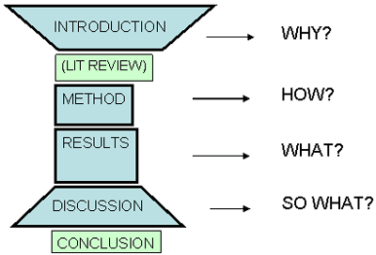
How to read an academic article
Generally, an academic article is structured by four main sections (i.e., IMRD)
I: Introduction
M: Methodlogy (or Methods)
R: Results (or Findings)
D: Discussion

Slide 4
How to read an academic article
Effective reading strategy:
Step 1: Read the title of the paper
Step 2: Read the abstract and introduction
The first two steps help you identify the relevant articles ☺
Step 3: Read the literature review section
Step 4: Read the discussion section
Step 5: Read the results section
Step 6: Read the methods section

Slide 5
How to read an academic article
An initial High-level Reading consists of the following elements:
Title: The title of the article. Contains important information about the study's main theoretical and/or empirical contribution.
Journal Name: Tells you which journal published the article; also provides insight into the discipline/field of study.
Authors and Affiliations: Tells you who wrote the article and with what organization or university they are affiliated.
Date of Publication: Tells you how recently the article was published.
Abstract: A high-level summary of the entire article. Is the article relevant to me and my interests? Should I continue reading?
Introduction: Outlines the contextual relevance of the study. Provides a clear theoretical, empirical and/or practical contribution of the study. What is the big idea? What are the authors trying to understand?

Slide 6
How to read an academic article
A deeper reading includes the following additional elements:
Literature Review: Some articles will include a Literature Review or Framing Literature section. This section describes relevant research studies. In business and management (or social science) articles in particular, it may be used to develop a conceptual or theoretical framework for the featured study.
Methods: Provides a summary of the methodological framework of the study. Includes some level of description of philosophical assumptions pertaining to the ontology and epistemology underpinning the study. Is there a clear methodological fit?
Results/Findings: Provides a summary of the findings from the study or experiment. May include charts, tables, graphs, and data visualizations. Do the results appear to answer the research question(s)?
Discussion: Provides a discussion of the findings and what they mean in relation to the research question or hypothesis, or the conceptual or theoretical framework. This section is where the authors present their interpretations of their findings. What do the results mean? Why are they important?
Conclusion: This brings the article to a close. May discuss the limitations of the study, potential sources of bias, or opportunities for further research. Do you agree with the authors’ conclusions?
Acknowledgements: This is where the authors express their gratitude to colleagues, mentors, journal editors, and the organizations that funded their research.
Bibliography/References/Works Cited: List of sources used when developing the study or writing the article.

Slide 7
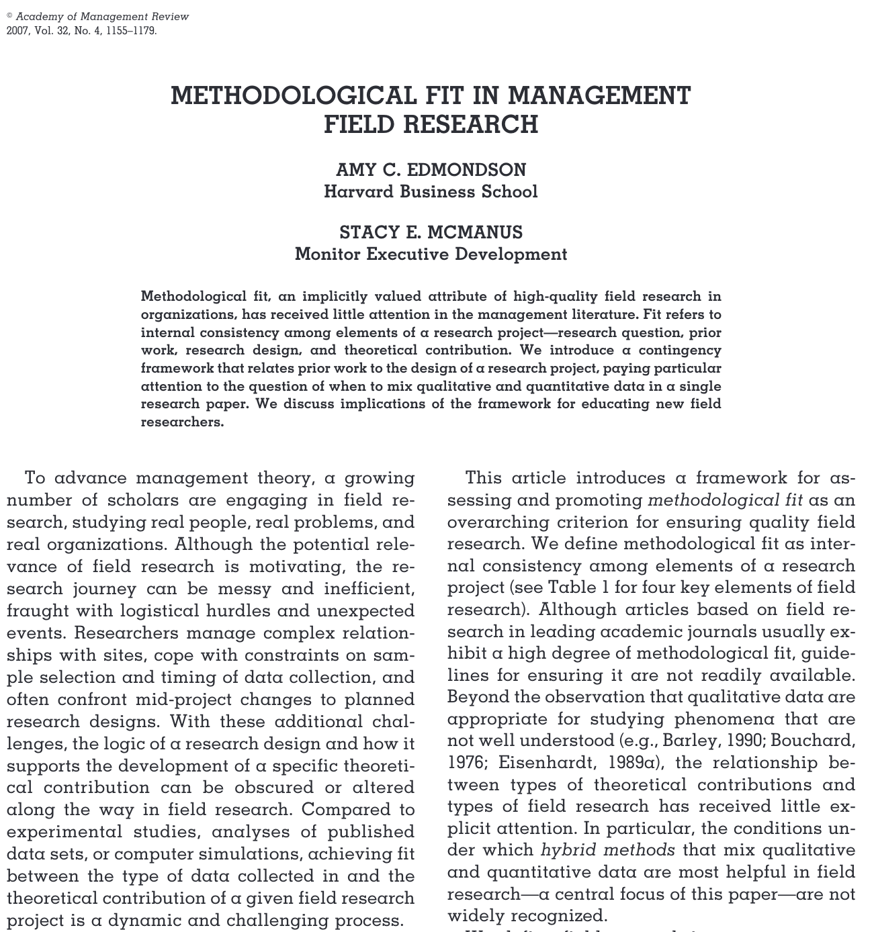
Methodological fit in management research.
Edmondson, A. C., & Mcmanus, S. E. (2007). Methodological Fit in Management Field Research. Academy of Management Review, 32(4), 1155–1179. https://doi.org/10.5465/AMR.2007.26586086

Slide 8
Activity One (Class Reading and Discussion)
1. Class reading and discussion around Management Research:
Listen to the Methodological Fit podcast and take detailed notes.
Organise into a total of three evenly distributed reading groups. Each group will be assigned one of the following articles recommended by Edmondson & Mcmanus’s (2007) article: Stewart & Barrick (2000), Barker (1993) and Edmondson (1999).
Sitting with your reading groups, read the paper assigned to your group.
To save time, spread the reading task evenly between all team members.
2. Working as a team, answer the following questions:
What is the big idea? What are the authors trying to understand?
Is there a clear methodological fit?
Do the results appear to answer the research question(s)?
What do the results mean? Why are they important?
Do you agree with the authors’ conclusions? Why?

Slide 9
Searching for academic literature
Aim:
In this topic you will learn how to develop a research question/objective/hypothesis
Objectives:
Formulate and refine a research question/statement or hypothesis
Evaluate the strengths and weaknesses of research question/statement or hypothesis
Formulate a research question

Slide 10
Why conduct a literature review ?
“We ask you to conduct a literature review, because we would like you to “read widely around the subject area in which you intend to conduct your research study.” (p.33)
“When reviewing the literature, you learn what aspects of your subject area have been examined by others, what they have found out about these aspects, what gaps they have identified and what suggestions they have made for further research.” (p.32)
“The literature review serves to enhance and consolidate your own knowledge base and helps you to integrate your findings with the existing body of knowledge.” (pp.31-32)
“The literature review helps you to integrate your findings with existing knowledge – that is, to either support or contradict earlier research.” (p.32)
Reference: Kumar, R. (2011). Research methodology: A step-by-step guide for beginners (3rd ed.). SAGE Publications Asia-Pacific Pre Ltd.

Slide 11
How to generate search terms
Step One: Create a research topic
Try to limit your topic to one sentence that fully describes your research. For example:
Effects of the media on the body image of young children
Trends in the use of information technology in the workplace
The use of risk and quality management tools in SMB

Slide 12
How to generate search terms
Step Two: List your key concepts
Now, identify at least two key concepts within your research topic. Each key concepts might be 1-2 words.
Discuss your key concepts with your team.
For example:
Your research topic is: The use of risk and quality management tools in SMB.
Key Concept 1: Risk
Key Concept 2: Quality
Key Concept 3: SMB

Slide 13
How to generate search terms
Step Three: Related search terms
Now, try to list at least 1 related search term for each of your key concepts. These might be synonyms, boarder terms, more specific terms etc.
Website for finding synonyms: www.thesaurus.com/
For example:
Key concept 1: Risk (related research terms: risk management, threat management)
Key concept 2: Quality (related research terms: excellence, improvement)
Key concept 3: SMB (related research term: small medium business)

Slide 14
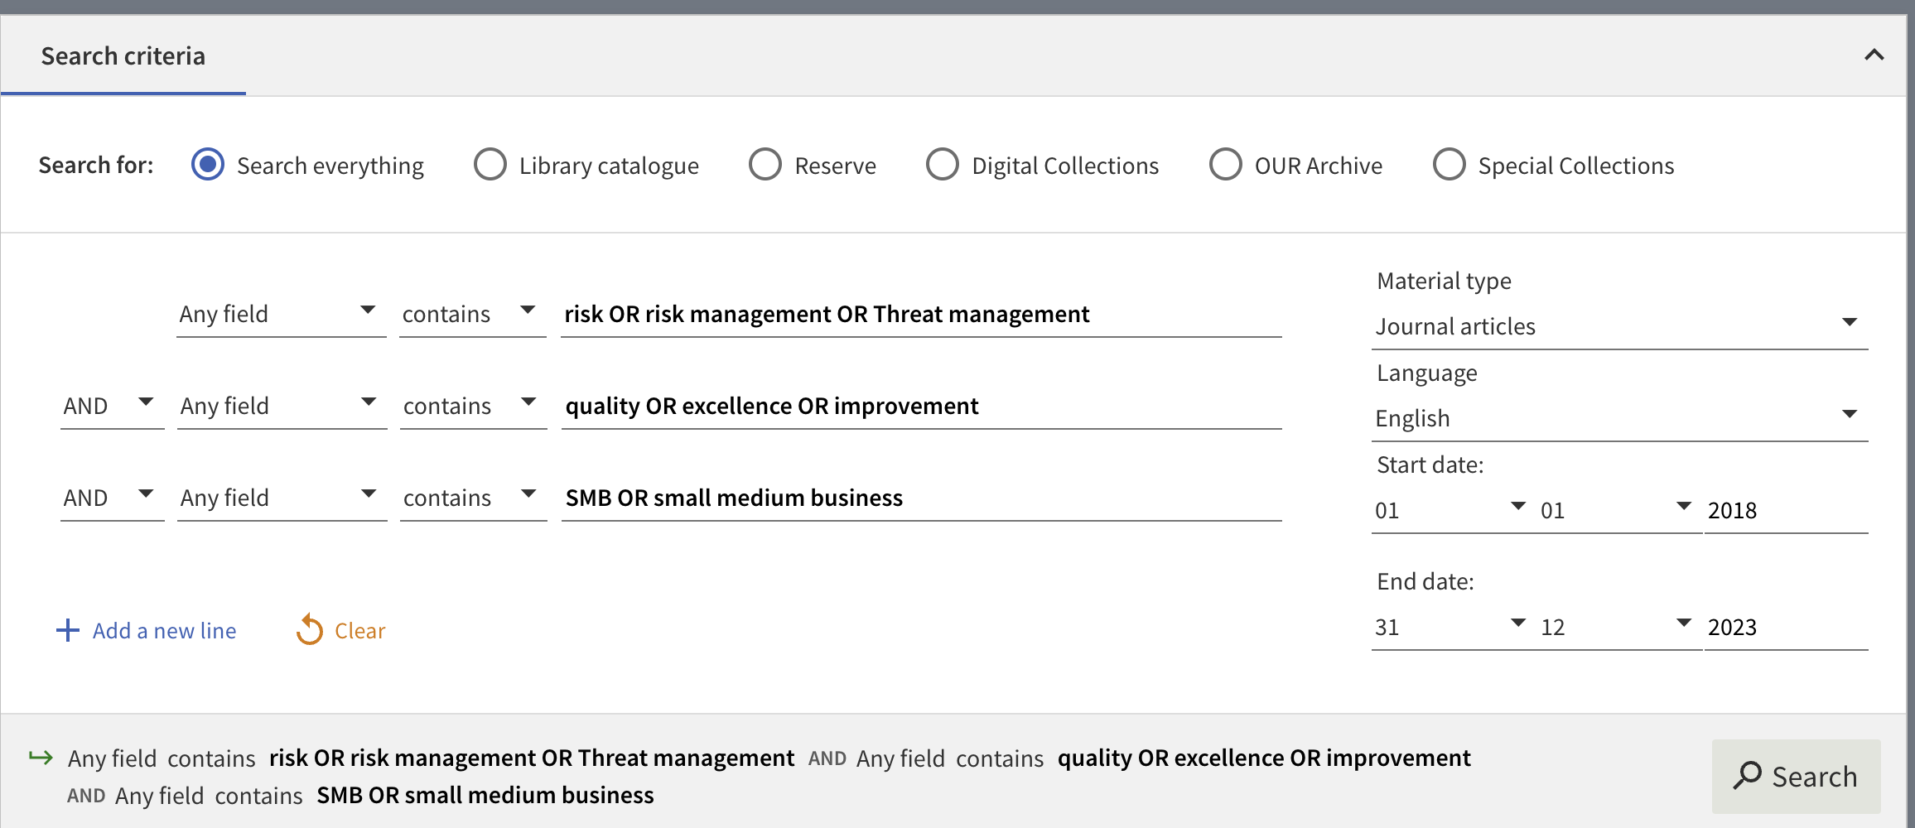
How to generate search terms
Step Four: How to use your search terms
Now that you've created your list of search terms, you will need to combine them using BOOLEAN operators (AND and OR). In your example, the combined search terms would look like this:

Slide 15
Literature Searching and Locating Information Sources
Library catalogues (e.g., Robertson Library): good for locating books held by a library, and journals to which they subscribe;
Search engines (e.g., Google): good for locating web pages with simple keyword-based searches; and,
On-line databases (e.g., Business Source Complete, Google Scholar): provide access to journal articles, papers in conference proceedings, reports, dissertations and other documents.

Slide 16
Where to search
Robertson Library: https://studentservices.op.ac.nz/library/
Business Source Complete: Robertson Library website – Databases – Databases listed A-C – Business Source Complete
Google Scholar: Robertson Library website – Databases – Databases listed D-G – Google Scholar

Slide 17
Developing a research question
Aim:
In this topic you will learn how to develop a research question/objective/hypothesis
Objectives:
Formulate and refine a research question/statement or hypothesis
Evaluate the strengths and weaknesses of research question/statement or hypothesis
Formulate a research question

Slide 18
What makes a good research question?
A research question is the question around which you centre your research. It should be:
Clear: it provides enough specifics that one’s audience can easily understand its purpose without needing additional explanation.
Focused: it is narrow enough that it can be answered thoroughly in the space the writing task allows.
Concise: it is expressed in the fewest possible words.
Complex: it is not answerable with a simple “yes” or “no,” but rather requires synthesis and analysis of ideas and sources prior to composition of an answer.
Arguable: its potential answers are open to debate rather than accepted facts.

Slide 19
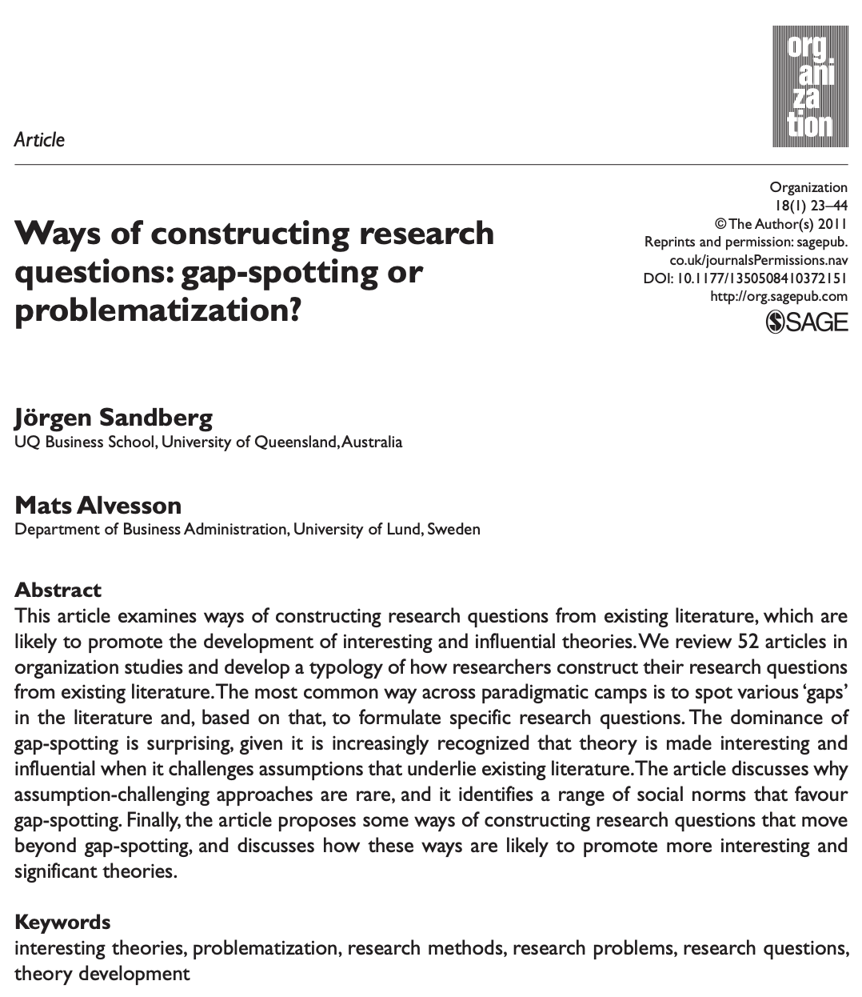
Ways of constructing research questions.
Sandberg, J., & Alvesson, M. (2011). Ways of constructing research questions: gap-spotting or problematization?. Organization,18(1), 23-44.

Slide 20
Activity Two (Individual)
1. Individual writing task:
Listen to the Constructing research questions podcast and take detailed notes.
Develop your topic from an area that you are really interested in.
Make sure your research topic is specific and relevant.
Write a draft research question based on the topic.
Seek feedback from the RMS chatbot on your research question.
2. Working as an individual, answer the following questions:
Does your draft research question provide enough specific details?
Is your draft research question narrow enough that it can be answered thoroughly in the space the writing task allows?
Is your draft research question expressed in the fewest possible words?
Does your research question require synthesis and analysis of ideas and sources?
Are potential answers to your research question open to debate rather than accepted facts?

Slide 21
Self-study
Download and work on the Literature Worksheet Template from the Week One Module on Teams
Find your primary article (and at least three supportive articles) for Assessment One.
Read all articles and complete all relevant cells for each article.
Ensure that the primary article is relevant to the identified applied management area/topic.
Ensure that the three supportive articles are related to the primary article.

